Slide 1
ECE - 593 Fundamentals of pre-silicon validation Winter- 2024 Design And Verification Of Asynchronous FIFO Using UVM
Session 1 – Group 7
Sai Teja Gali saitejag@pdx.edu
Sandeep Goud Abbagouni sandeepa@pdx.edu
Abhishek Kumar Reddy Musku abhimusk@pdx.edu

Slide 2
Team Introduction
Sai Teja Gali
Second Quarter at PSU
Took “Intro to SV” & “Microprocessor System Design” courses in first term
Worked on 1 SystemVerilog project in previous term
Graduation Date: Jan, 2026
Sandeep Goud Abbagouni
Second Quarter at PSU
Took “Intro to SV” & “Microprocessor System Design” courses in first term
Worked on 1 SystemVerilog project in previous term
Graduation Date: Jan, 2026
Abhishek Kumar Reddy Musku
Second Quarter at PSU
Took “Intro to SV” & “Microprocessor System Design” courses in first term
Worked on 1 SystemVerilog project in previous term
Graduation Date: Jan, 2026

Slide 3
Project Description
Asynchronous FIFO is intended to transport data across multiple clock domains in a secure manner, which is a typical requirement in digital systems with components that run at different clock frequencies.
Objective of the project is to design and verify the Asynchronous FIFO using UVM.
Designed Asynchronous FIFO comprising write pointer, read pointer, memory , binary to gray converters, synchronizers, and full, empty, half empty, half full flags.
Developed class based verification and UVM based based verification for the FIFO for multiple test scenarios
Achieved coverage of XX by performing tests using various test case scenarios under randomized and constrained inputs.

Slide 4
Roles & Responsibilities
Abhishek Kumar Reddy:
Design modules: Write Pointer, Full logic & Half full logic, Sender and Receiver.
Verification Modules: Agent, Environment, coverage and Integration of all modules.
Sandeep Goud Abbagouni:
Design modules: Read Pointer, Empty logic & Half empty
Verification Modules: Sequence_item, sequence, sequencer and Integration of all modules.
Saiteja Gali:
Design modules: FIFO memory and synchronizers , Design top module.
Verification Modules: Driver, monitor, scoreboard and Integration of all modules.

Slide 5
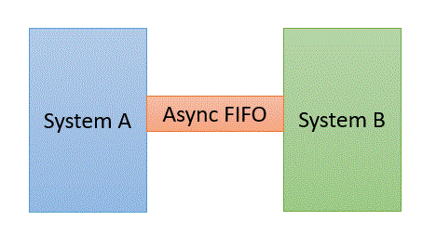
FIFO Design
Asynchronous FIFO is used as temporary storage (Buffer)
Helps to synchronize data flow between two systems working on different clocks

Slide 6
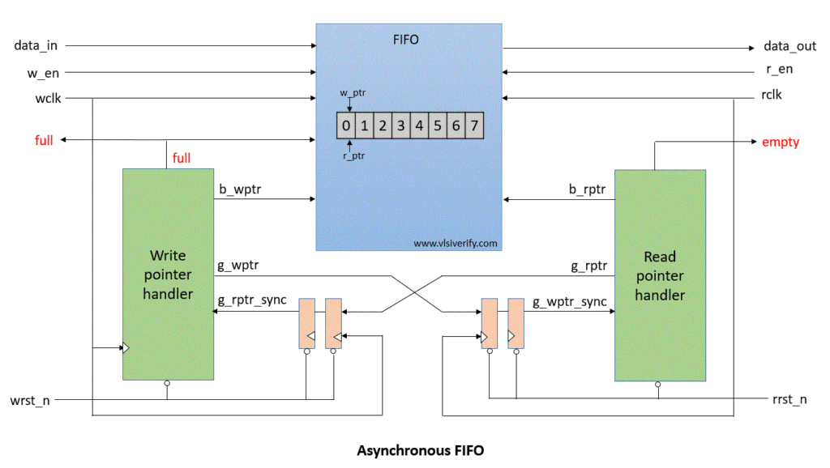
Design
Four Main Components
FIFO Memory module
Write pointer module
Read pointer module
Synchronization modules
Half_full
Half_empty

Slide 7
Design implementation
Full flag condition
Half Full condition
Empty condition
Half empty condition

Slide 8
Design implementation
The primary design for this project is sourced from http://www.sunburstdesign.com/papers/CummingsSNUG2002SJ_FIFO1.pdf
We have implemented the FIFO design according to the required depth, Clock frequencies, wait cycles
We have introduced the flags for Half_empty and Half_full conditions.
Used Gray to binary and vice versa converters for calculating the flags

Slide 9
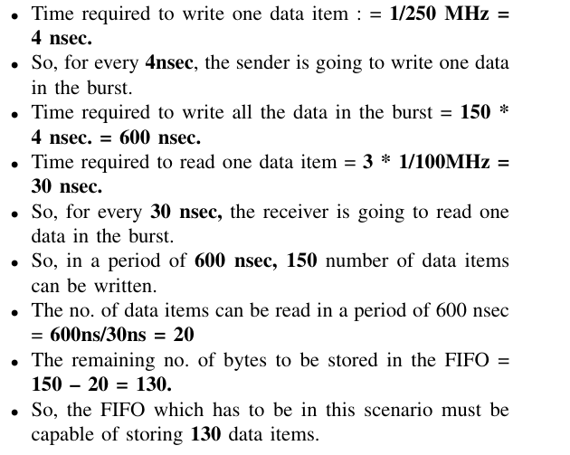
Design Specifications and Calculations
Producer clock frequency = 250 MHz
Consumer Clock frequency = 100 MHz
Duty cycle = 50%
Maximum write burst size = 150
Number of ideal cycles between successive writes = 0
Number of ideal cycles between successive reads = 2
Minimum FIFO Depth = 130

Slide 10
Design Specifications and Calculations
We have implemented the FIFO with the depth of 256 which will cover the required minimum depth of 130

Slide 11
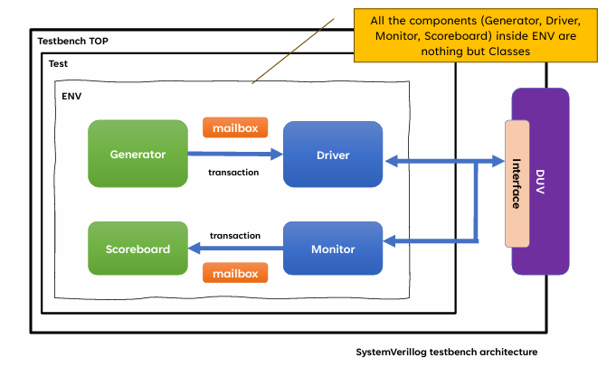
Class Based Verification
Test bench architecture

Slide 12
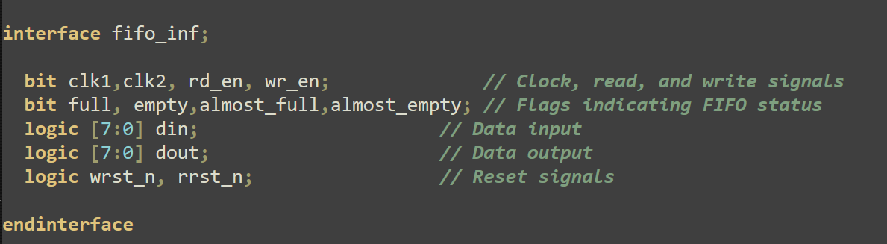
Interface
To connect DUT to the test bench we need interface
It consists of input and output signals of the DUT

Slide 13
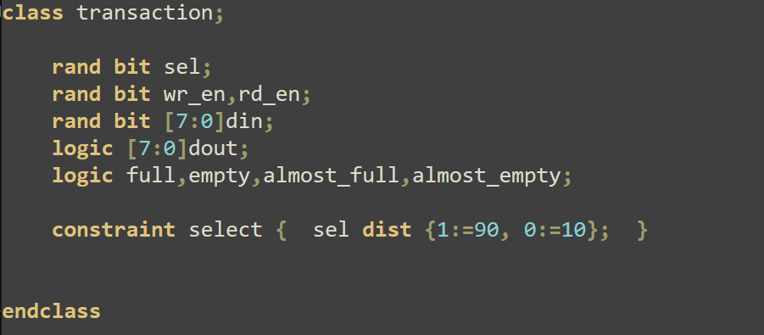
Transactions
In order to send transactions to the DUT we need transaction class
Consists of data items that will be sent to and from the DUT.

Slide 14
Class Based Components
Generator
Allocated memory for transaction data items and randomized them
Driver
Sent the different transactions to the DUT through virtual Interface
Monitor
Received the Output from the DUT through virtual Interface
Scoreboard
Verified the Output from the DUT using temporary queue

Slide 15
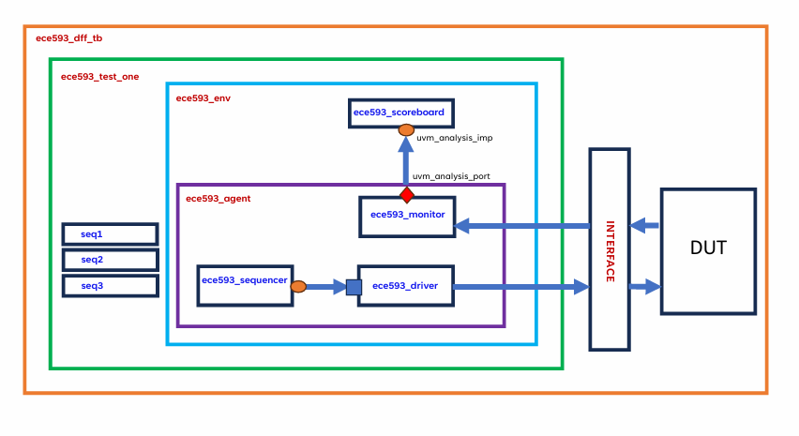
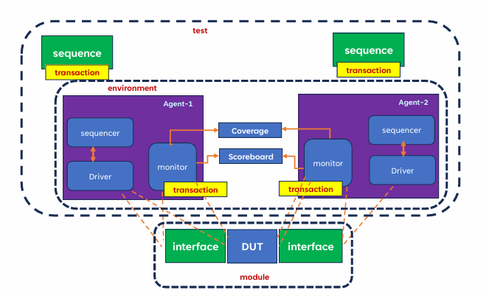
UVM Architecture

Slide 16
UVM Based Verification
Developed UVM based verification by implementing the following classes, objects and components
Sequence item
Sequence
Sequencer
Driver
Monitor
Scoreboard
Agent
Environment
Test
Interface

Slide 17
Test Scenarios
Written following sequences in UVM to check the below scenarios
Reset – To reset the FIFO
Random read and write – Using randomization and constraints, gives input to FIFO
First write the FIFO full and then read till FIFO is empty
Complete write until the FIFO is Full
Reading and writing at the same time

Slide 18
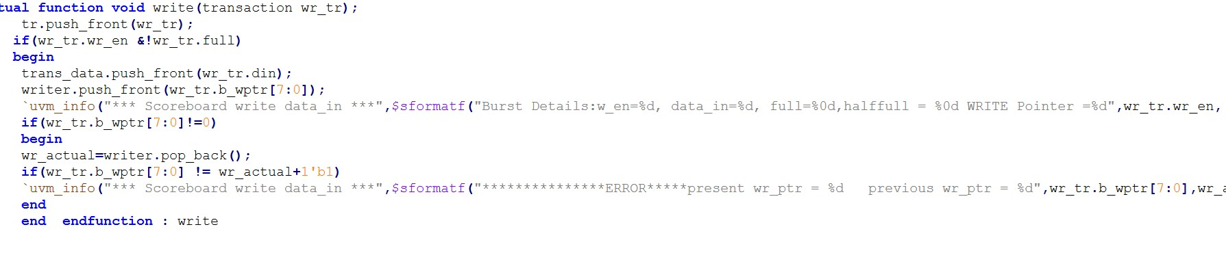
Bug injection in the Design & it’s detection
Hardcoded the Write pointer to value 1 instead of incrementing it based on write enable and full flag in wptr_handler1.sv
In the UVM scoreboard, implemented a special condition to compare present and previous values of write pointer to check if its incrementing correctly and catch the bug

Slide 19
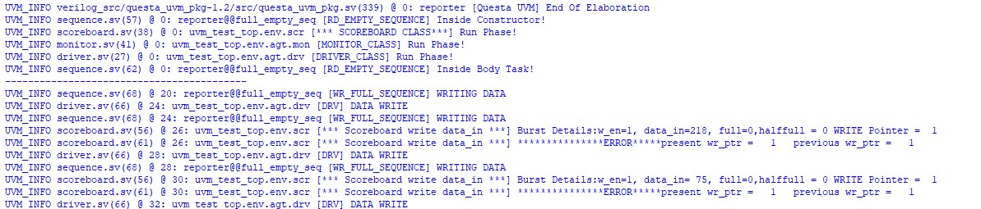
Bug injection simulation output

Slide 20
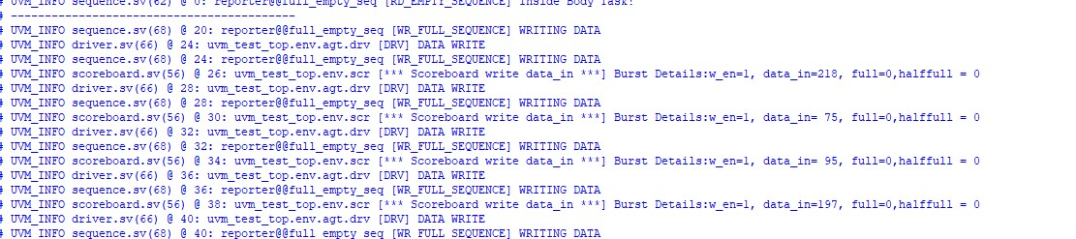
Simulation results
Write to FIFO

Slide 21
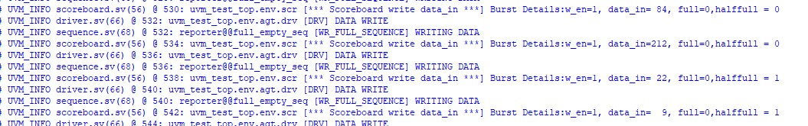
Simulation results
Write to FIFO (Half Full)

Slide 22
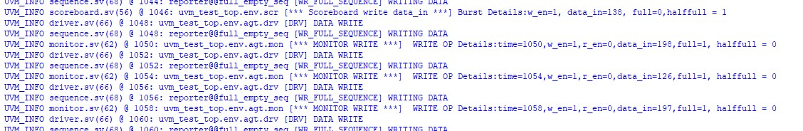
Simulation results
Write to FIFO (Full)

Slide 23
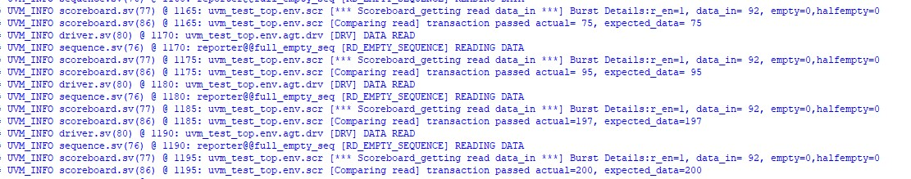
Simulation results
Read from FIFO

Slide 24
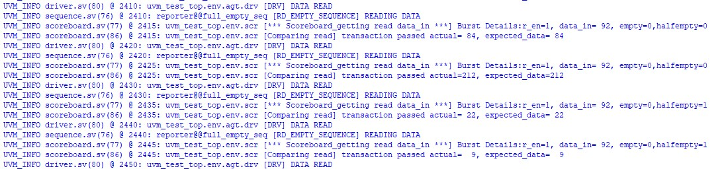
Simulation results
Read from FIFO ( Half empty)

Slide 25
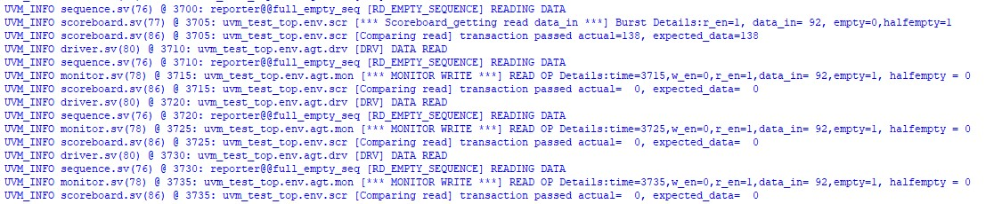
Simulation results
Read from FIFO (Empty)

Slide 26
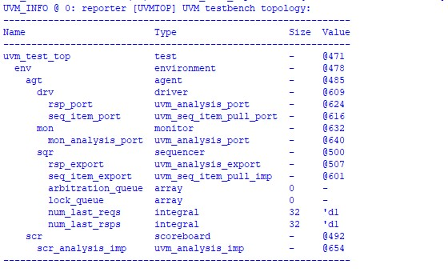
UVM Topology

Slide 27
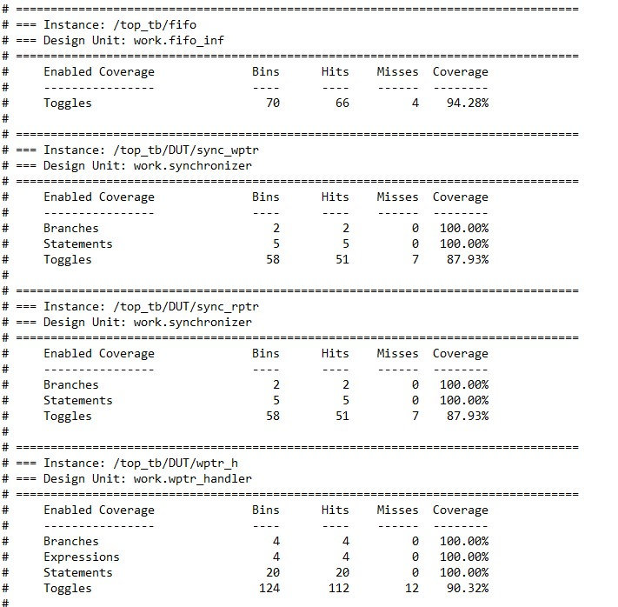
Coverage Metrics – Code Coverage

Slide 28
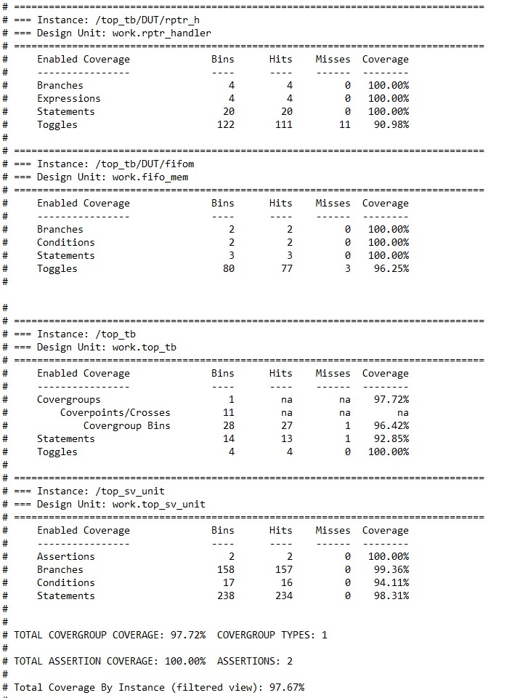
Coverage Metrics – Code Coverage
Code coverage : 97.67%

Slide 29
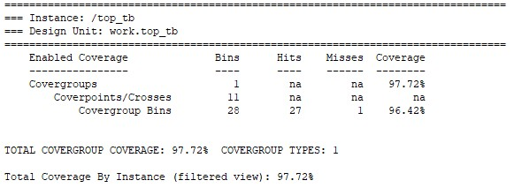
Coverage Metrics – Functional Coverage
Functional Coverage : 97.72%

Slide 30
Challenges Faced
Implementation of half empty and half full in the design
Implementation of Design top
Comparison of read pointer and write pointer to check the empty and full conditions
Synchronization of transactions in the test bench
Coverage implementation
Injection of bug
Detection of Bug using the UVM testbench

Slide 31
Learnings
Synchronization of threads in class based verification using events
UVM architecture learning
Synchronization using Handshake Mechanism
Connecting monitor to scoreboard using analysis port
Writing cover groups and bins for functional coverage

Slide 32
Github link
https://github.com/saitejagali/team_7_Async_FIFO

Slide 33
References
http://www.sunburstdesign.com/papers/CummingsSNUG2002SJ_FIFO1.pdf
Chip verify -https://www.chipverify.com/systemverilog/systemverilog-class
Verification Academy - https://verificationacademy.com/
UVM Primer -https://www.youtube.com/watch?v=eeU2zpgXv1A&list=PLigQ6Cc3qFpI_WTgqtDXi_Msk3yRuKGGJ&index=2
Chatgpt - https://chatgpt.com/?oai-dm=1

Slide 34


